Slide 1
Non-Cancer Region Identification –Prostrate Cancer
Bharat Nagaraju – A0178258N
Vigneshram Selvaraj - A0178215A

Slide 2
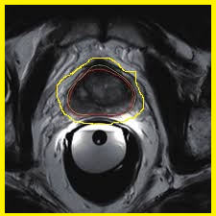
Objective
Objective is to identify Non Cancer region from a cancer image dataset
From radiation treatment point of view, if we can have the highest level of confidence that a certain zones is cancer free, then we can reduce the radiation zone to that area and thereby decrease side effects.

Slide 3
Hazards from existing methods
A common worldwide problem is that radiation causes rectal proctitis in 10% of patients.
Various methods have been used to reduce this but those methods are often invasive e.g. Brachytherapy.
If we're able to identify that areas near the rectum are cancer free, then we can reduce the radiation dose to these areas and thereby reduce the rate of proctitis & cystitis

Slide 4
About the Data Set
We have primarily used Promise12 Dataset (Automatic Cancer Segmentation Challenge)
Consists of 3D MRI transversal T2-weighted image of the prostate.
The data is well balanced such that there is a spread in prostate sizes and appearance.
50 Training Images and 30 Test Images
2. We have used MICCAR 2019 – 2D Slices of 3D Prostrate Image. Used for Experimentation purposes

Slide 5
Existing Solutions & Challenges
U-NET has been unanimously used since 2015 in various competitions and challenges and various improvisations such as addition of residual layers, 3D u-Net and other variants of U-Net are already available
Although there are numerous variants, results are not reproducible for most of the research work and hard to pick the best model for cancer detection.
Only way is try to run a few models, evaluate and pick the best performing network to design the solution forward

Slide 6
Proposed Solutions
Identify the best performing model from a group of three or four available solutions
Evaluate the model performance using K-Fold Cross validation and Dice-Coefficient of the model for Cancer region segmentation
Once the Cancer region is segmented with minimal error, a bounding region of the same region with some space is drawn around the segment to identify the non-cancer region. By this, Other regions are reduced from exposure to harmful radiations

Slide 7
Choice of Solutions
Naas U-Net: Promising in theory. Good results on paper. Provided pre-trained model was used to generate test predictions. DSC – 0.68 Paper DSC – 0.98
Attention UNet (UNet with attention gates to make training focus on Region of Interest - DSC of 0.812 Paper DSC - .804)
Fully convolutional neural network with residual connections for automatic segmentation of prostate structures[Original Dsc – 83.12. After Changes – 88.12]
Hyperdense-Net: A hyper-densely connected CNN for multi-modal image segmentation [High Training Time- Not really useful in this case]

Slide 8
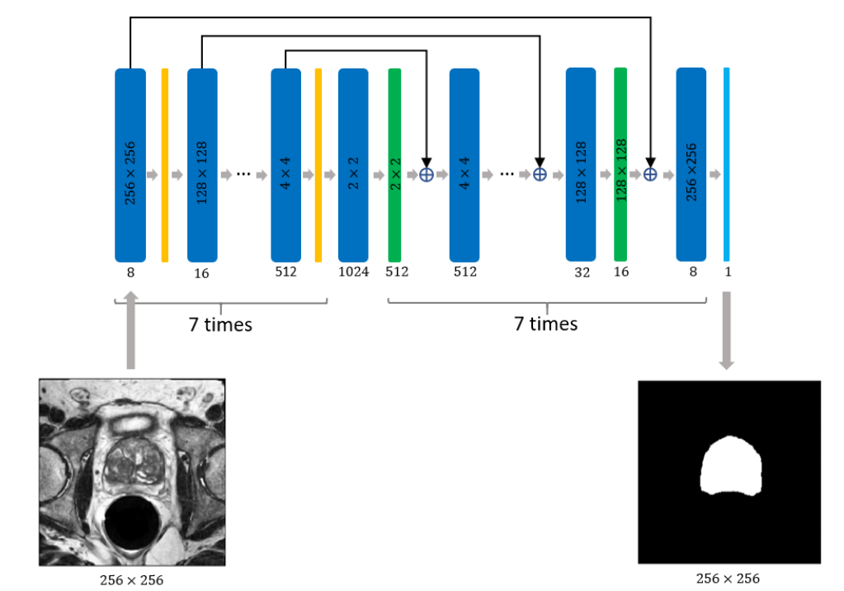
Improvised Approach Architecture Fully convolutional neural network with residual connections

Slide 9
Architecture Details
The model has a contracting path to capture context and a symmetric expanding path that enables precise localization.
In the upsampling part, a large number of feature channels propagate context information to higher resolution layers. This eliminates the issue of low localization accuracy.
Excessive data augmentation is done by applying elastic deformations to the available training images. This helps the model to learn and generalize with very few training images.
A weighted loss function is designed to assign a large weight where the separating background labels are touching cells. This helps to distinguish the background more precisely.

Slide 10
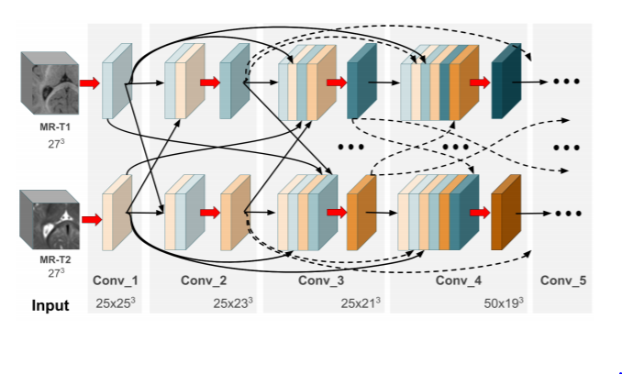
Experimental Model with MICCAR 2019
In DenseNet the concept is to connect with the input of each layer corresponding to the outputs from all previous layers.
These connections back-propagate gradients directly, thereby mitigating the gradient-vanishing problem.
This helps learn more complex features between the layers using late fusion strategy.

Slide 11
Experimental Model with MICCAR 2019
The baseline approach:
Majority label Voting from different domain experts
Random shuffling 80% train 20% val split
512x512x3 input patches as used in the original paper of 2d-Unet
Generate sample dataset roughly ~50 patches per input image
Train with Unet without data augmentation
Multi class dice loss functions will be used.
After the baseline experiment further ideas/practices can be tested:
Split the dataset based on slice number and not randomly!
Apply Common data augmentation techniques
Examine input down sampling option
Use more recent model architectures and compare them to the baseline
Multiscale feature extraction would be a cool idea since image dimension is high
Even though it is shown that 25GB of RAM are available, could not store more than one inputs patch per image in memory.
Saved only the crop width and height but then then loader was really slow (4 sec to load, crop and preprocess the image and 2,5 sec with 2 workers- which is still slow).
Changed the code to store only one patch per train image and changed the training patches every 50 sub epochs.(similar to https://arxiv.org/abs/1804.02967)
The optimal solution would be to store the preprocessed generated image patches in my drive and load at runtime.
Resource Intensive!!!!

Slide 12
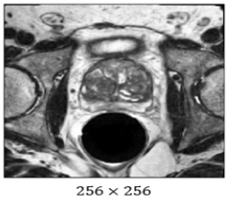
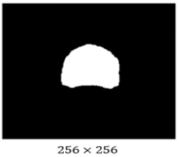

Solution Design
How to identify non-cancer region:It is challenging otherwise to manually segment masks of the cancer region which is present in different shapes and sizes

Slide 13
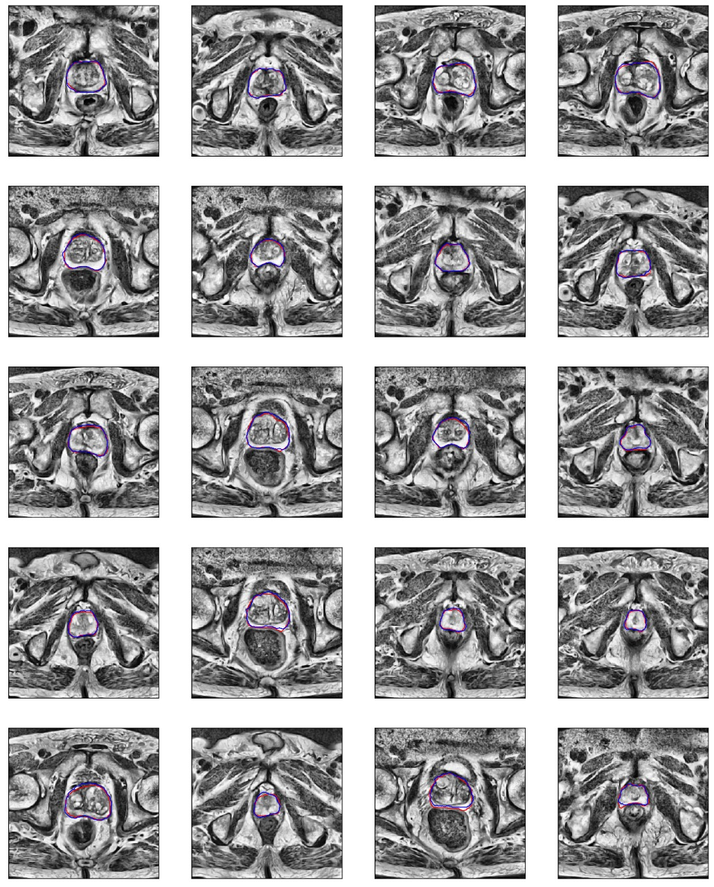
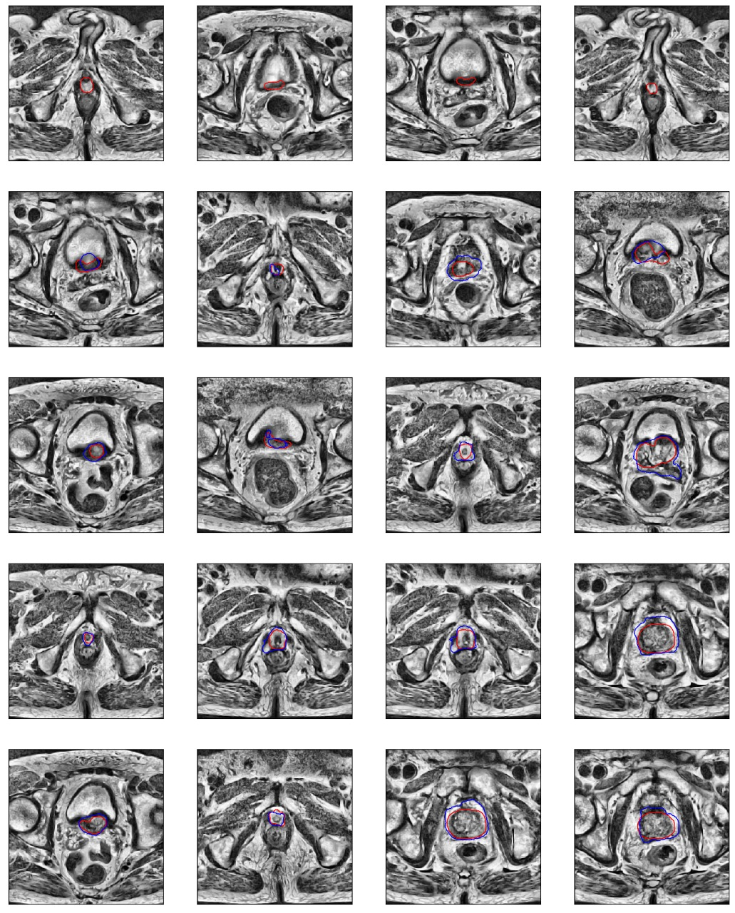
Best Predictions & Worst Predictions

Slide 14
Results & Inference
Built a UI Application to test the model and show the inference as below
Use the best performing model that segments the cancer region
To take in a 3D MRI Image and display multiple segmented images with Cancer and Non-Cancer region - Marked in Red and Yellow Respectively
Lab assistants can help to validate the results
Non-Cancer region or the Mask in Yellow is generated by resizing the predicted cancer region mask and superimposing it on the original MRI Image in a different color.

Slide 15
Are We good to use it in Lab?
This model can be used to identify Cancer and non-Cancer region and has to be evaluated in the labs
Medical experts intend to use this to identify non-cancer region WITHIN cancer region

Slide 16
Future Work
Labels / Masks of the image segments need to be created for non-cancer region and the model can be retrained on the newer dataset with a bit of hyperparameter tuning
Improve the model performance using any state of art model at that time since non-cancer region within the cancer region is even a smaller segment and more challenging to improve the accuracy

Slide 17
Thank You

